Slide 1
KNN
Ø
GMM
Covar

Slide 2
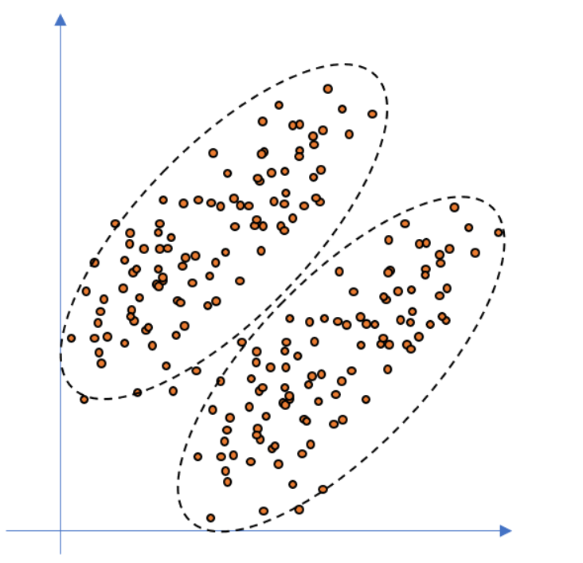


$π_{1}$ ≈ 0.5
$π_{2}$ ≈ 0.5

Slide 3
